Slide 1
.NET Development on AWS is not Terrible
KCDC Session

Slide 2

About me
Lead the technology and engineering teams at Headspring.
More than 18 years’ experience developing software, managing teams, connecting people within organizations and whispering.
Experience in architecture, cloud, devops, and everything in between. I may not know the answer, but I’ll know how to find it.
Am actually pretty terrible at ping pong.
Houston .NET Users Group, TEALS Volunteer
Bachelor’s degree in Computer Science and MBA from University of Houston (Go Coogs!)
Garo Yeriazarian
https://www.garoyeri.dev
Software Whisperer
(and Principal Consultant)
https://twitter.com/garoyeri

Slide 3


Applications
Software consulting and development
Building better software
to propel businesses into the future
Microservices
We make it
#missionpossible
Cloud & DevOps
Data Architecture
Legacy Modernization
Notes:
I’m at Headspring, a software consulting and development firm delivering solutions from application development to architectural strategy to legacy system transformation
We are a titanium sponsor
Stop by our booth
We’re hiring! See how we make both career growth and our client’s goals mission possible

Slide 4
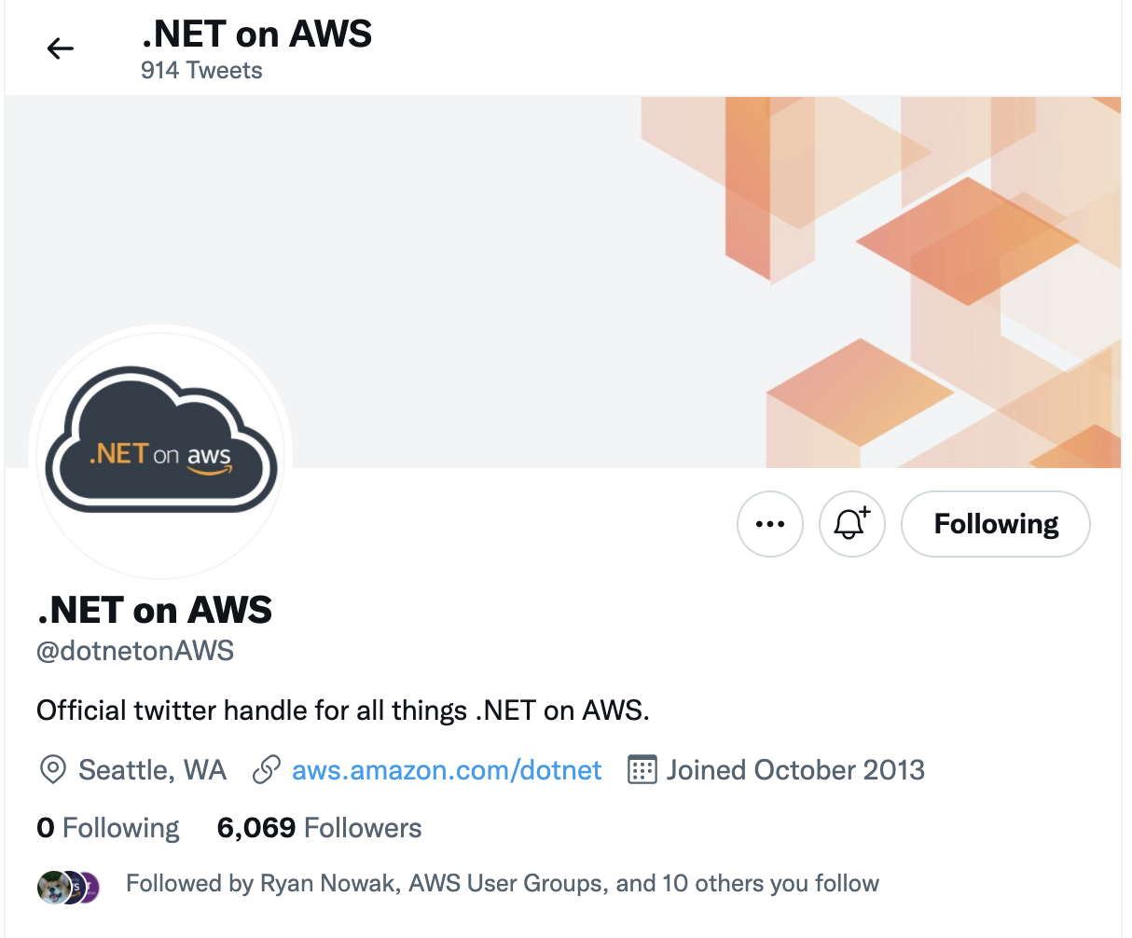
News about .NET on AWS is not terrible
Follow @dotnetonAWS for posts, news, and updates about how .NET is being used on AWS
https://twitter.com/dotnetonAWS

Slide 5
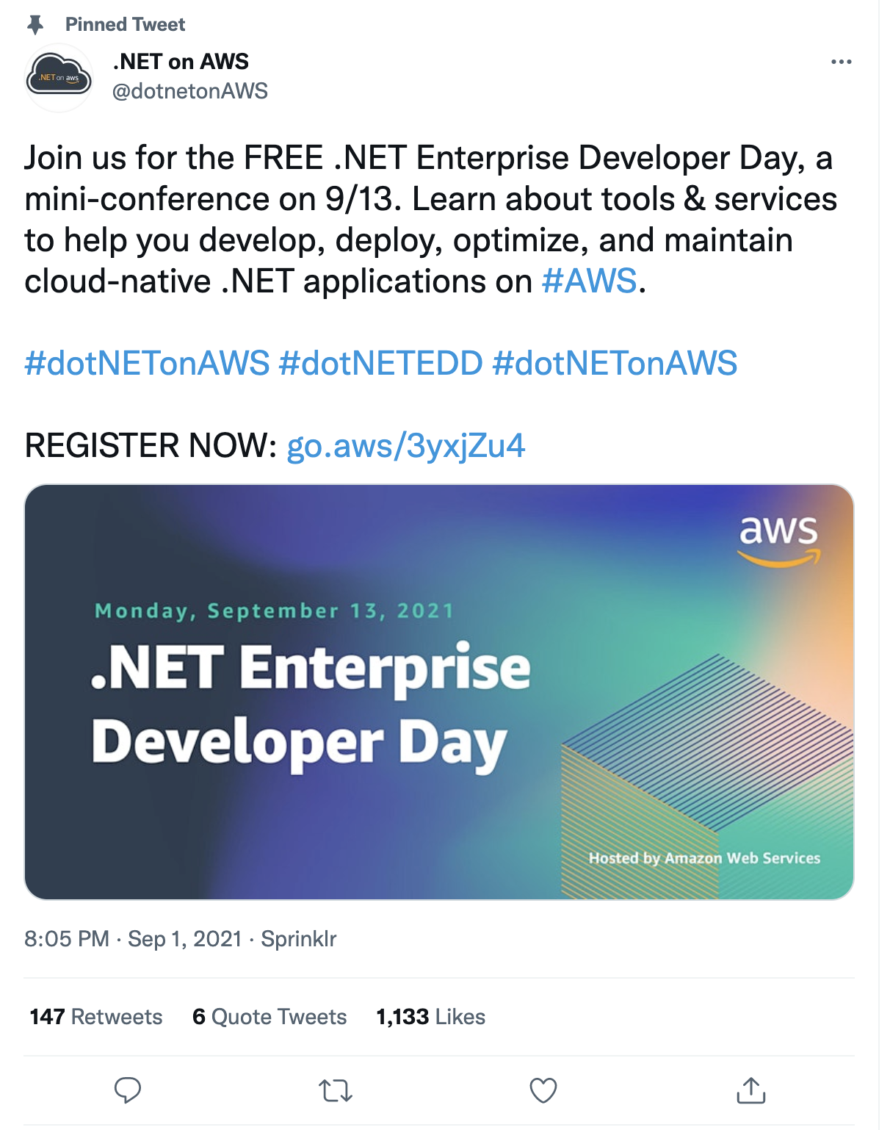
Free online conferences about .NET on AWS is not terrible
Oh hey, this conference was this past Monday, 9/13 recordings will be posted (eventually)

Slide 6
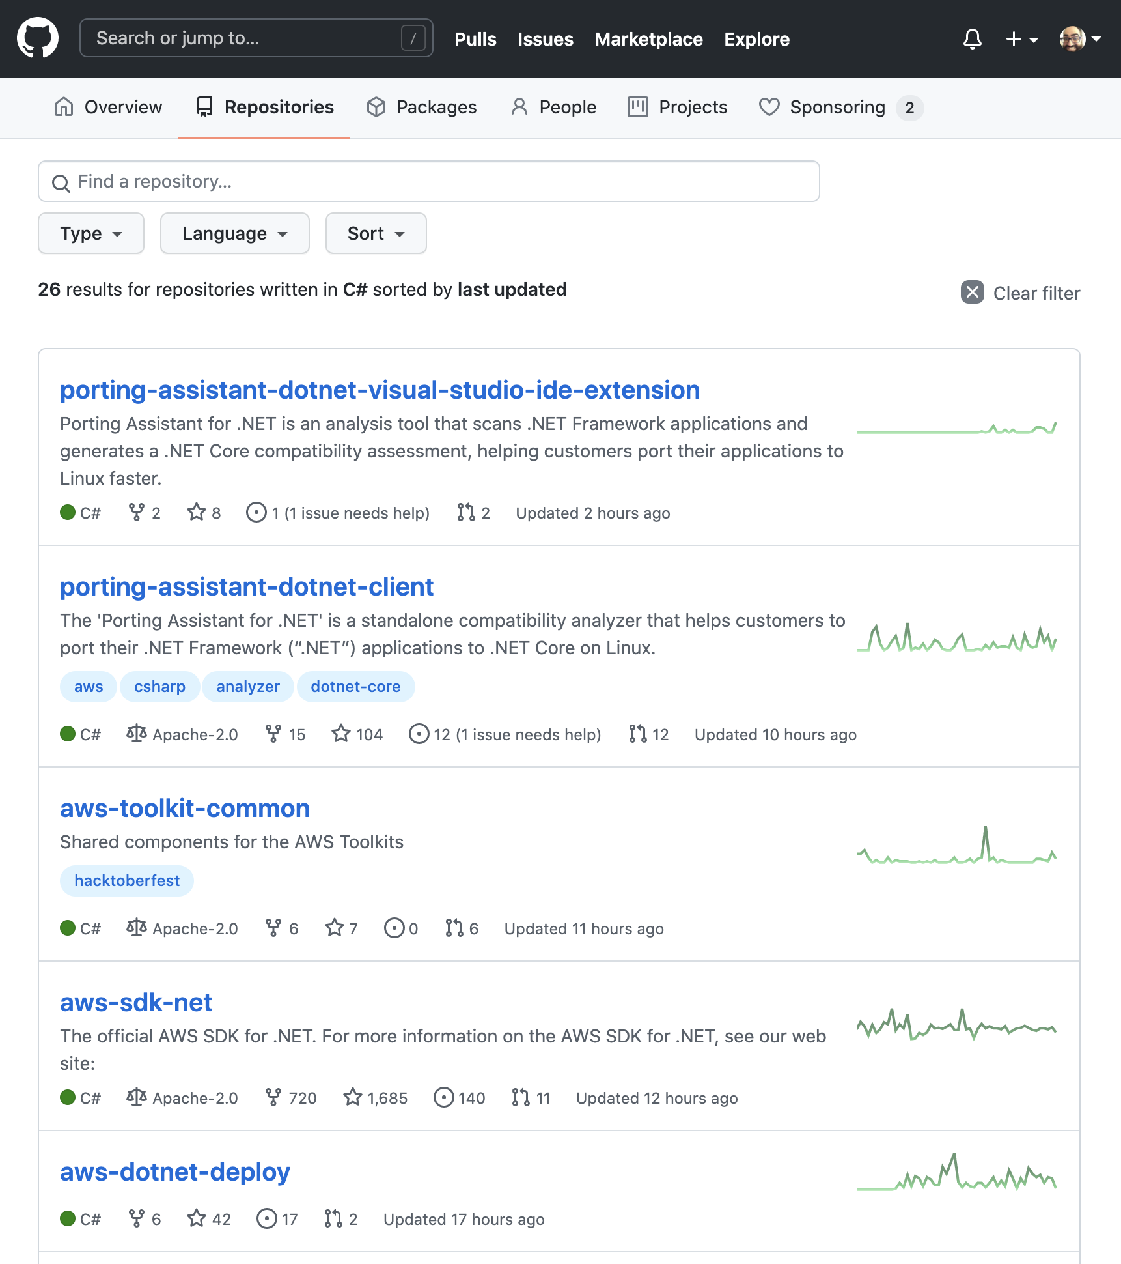
Open source SDK and Tools for .NET on AWS is not terrible
.NET Lambda SDK: https://github.com/aws/aws-lambda-dotnet
.NET AWS SDK: https://github.com/aws/aws-sdk-net
.NET Tools for AWS: https://github.com/aws/aws-extensions-for-dotnet-cli
AWS Tools for Powershell: https://github.com/aws/aws-tools-for-powershell

Slide 7
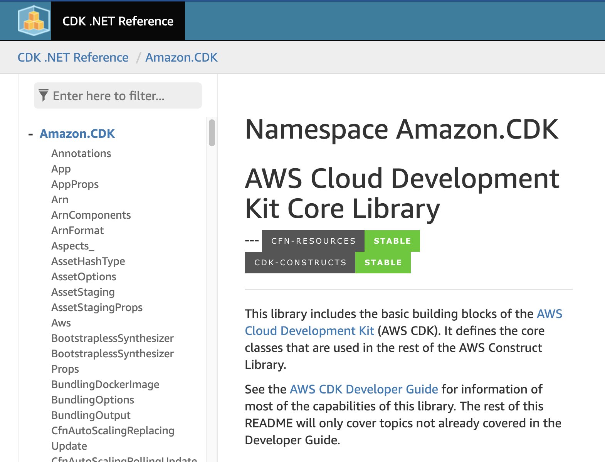
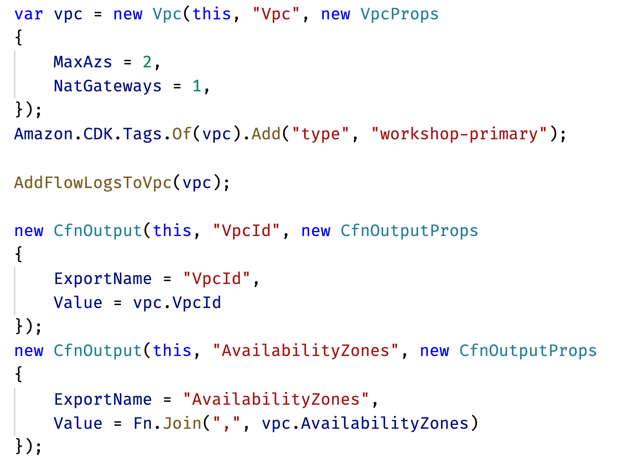
AWS CDK Deployments with C# (is not terrible)

Slide 8
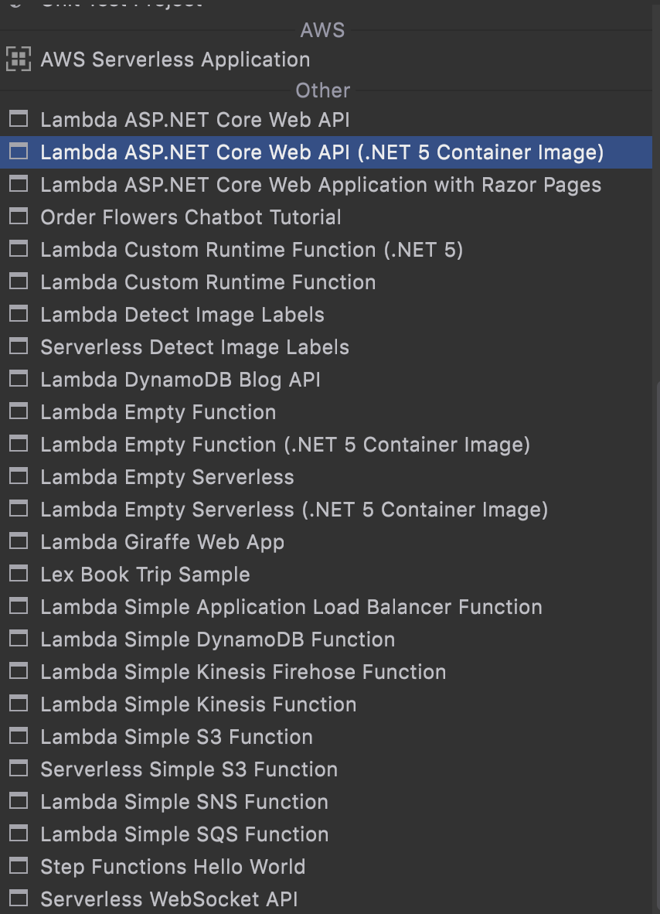
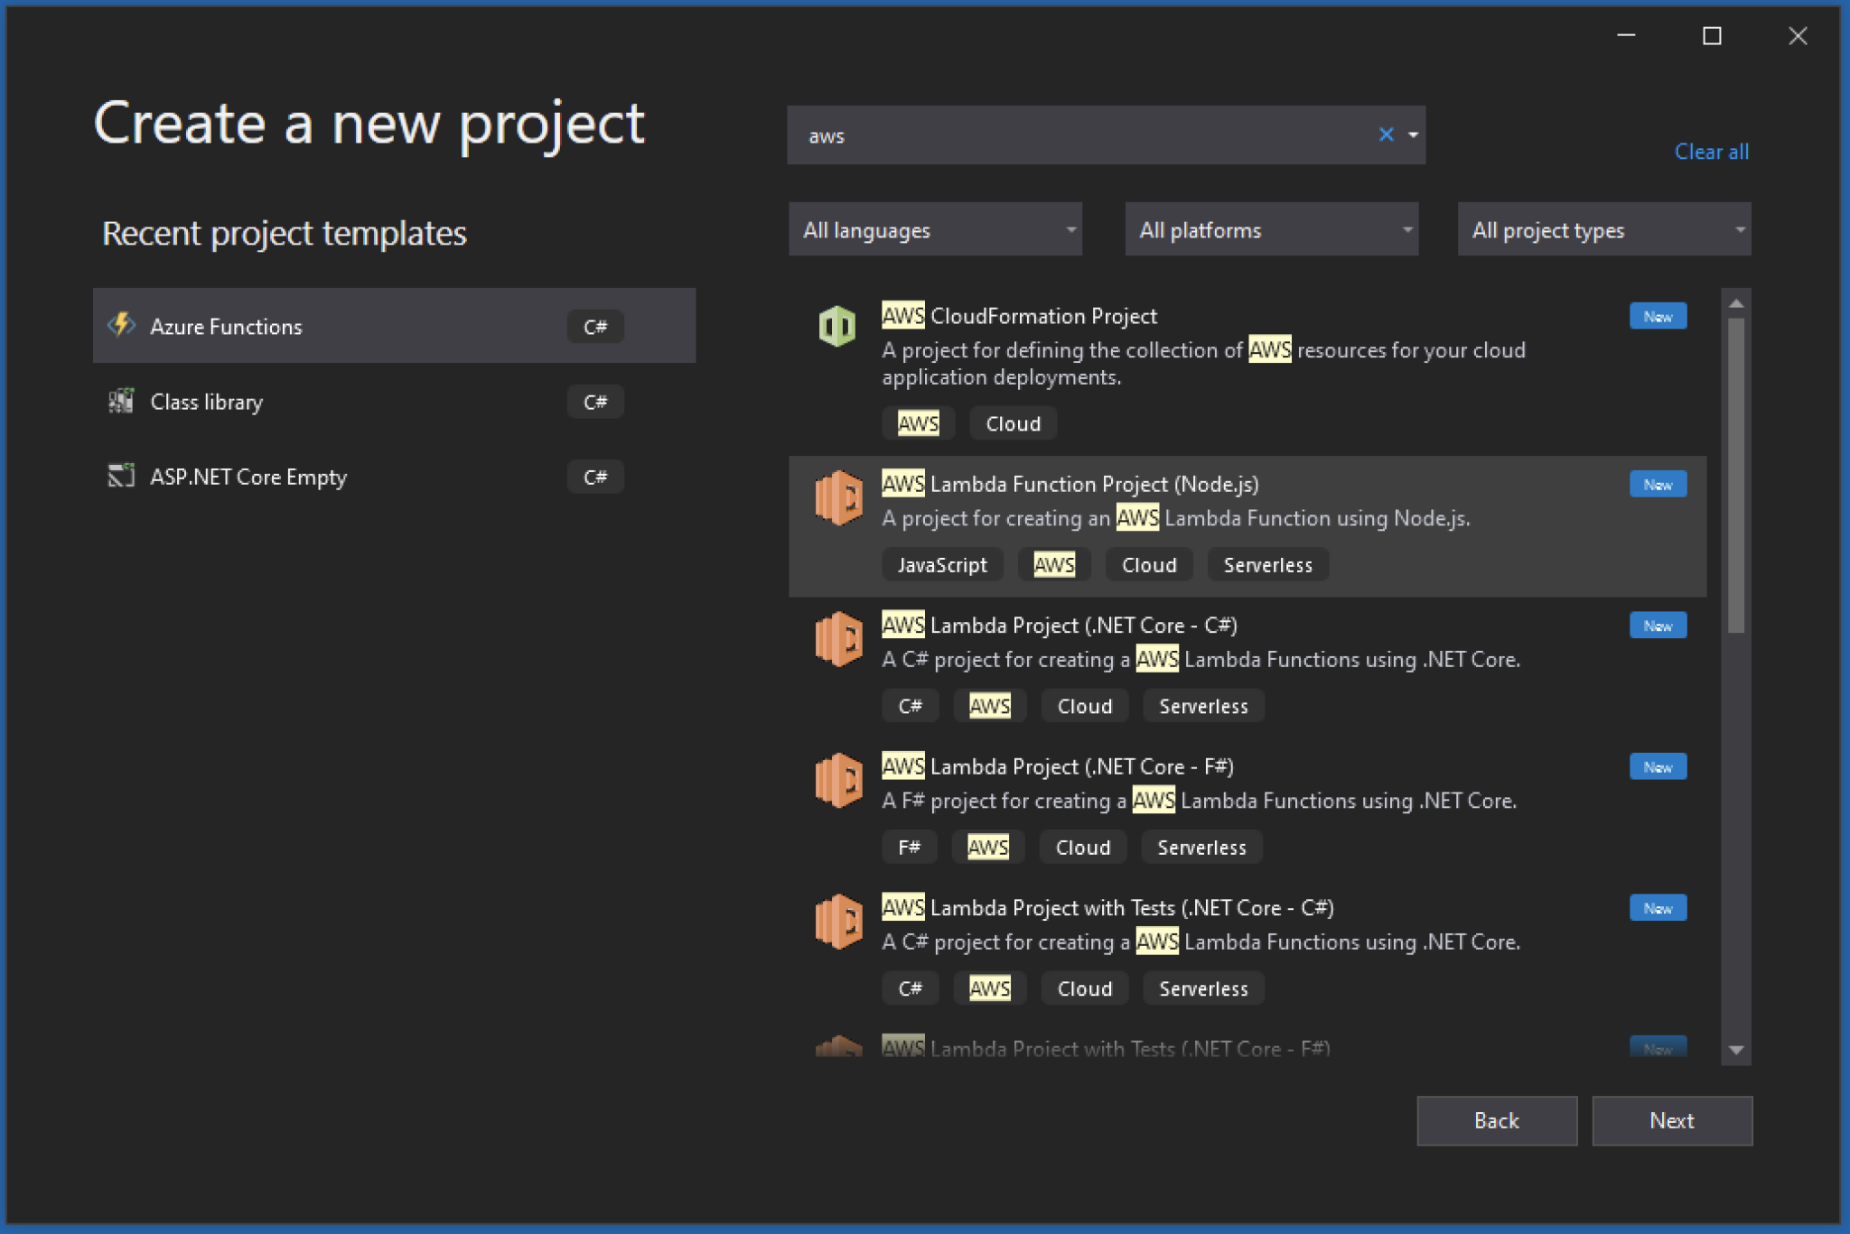
IDE Template Support for AWS in .NET is not terrible

Slide 9
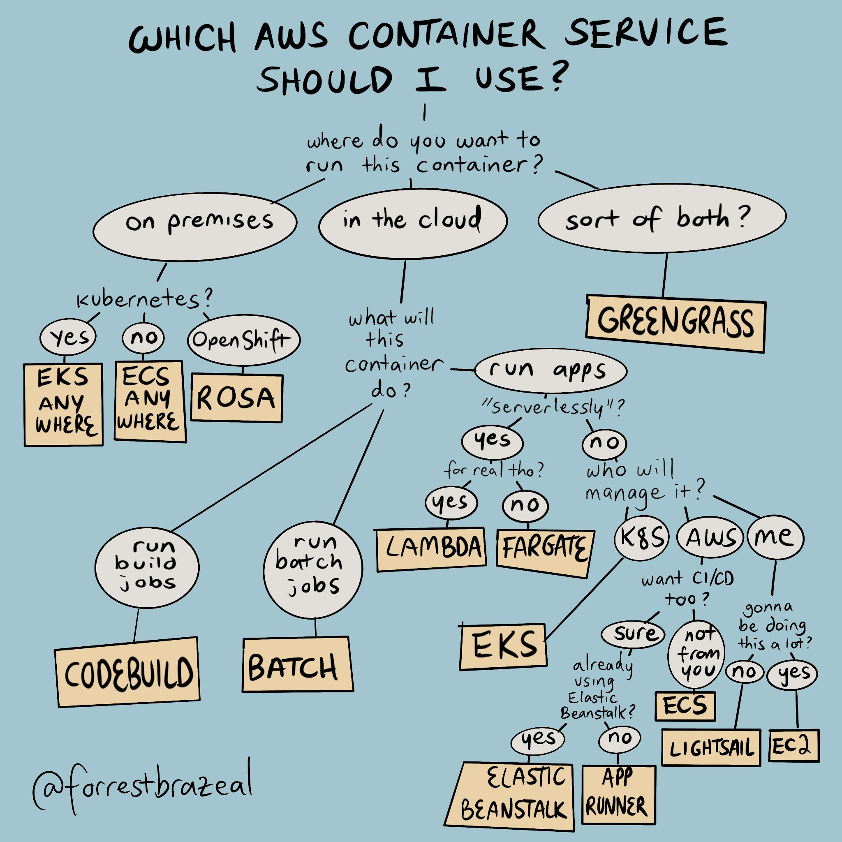
Deploying containers (with .NET) on AWS is not too terrible
Ok, I’ll level with you, there are a LOT of ways to deploy .NET code in AWS, and some seem to be at odds with each other.
https://twitter.com/forrestbrazeal/status/1400639759215640577

Slide 10
Some Code Examples of .NET on AWS … are not terrible
Using C# to build up Deployment templates for CDK
Setting up a local DynamoDB and using it
Pulling secrets from Secrets Manager
Running EF Core migrations from Lambda
Receiving SQS messages in a Lambda

Slide 11
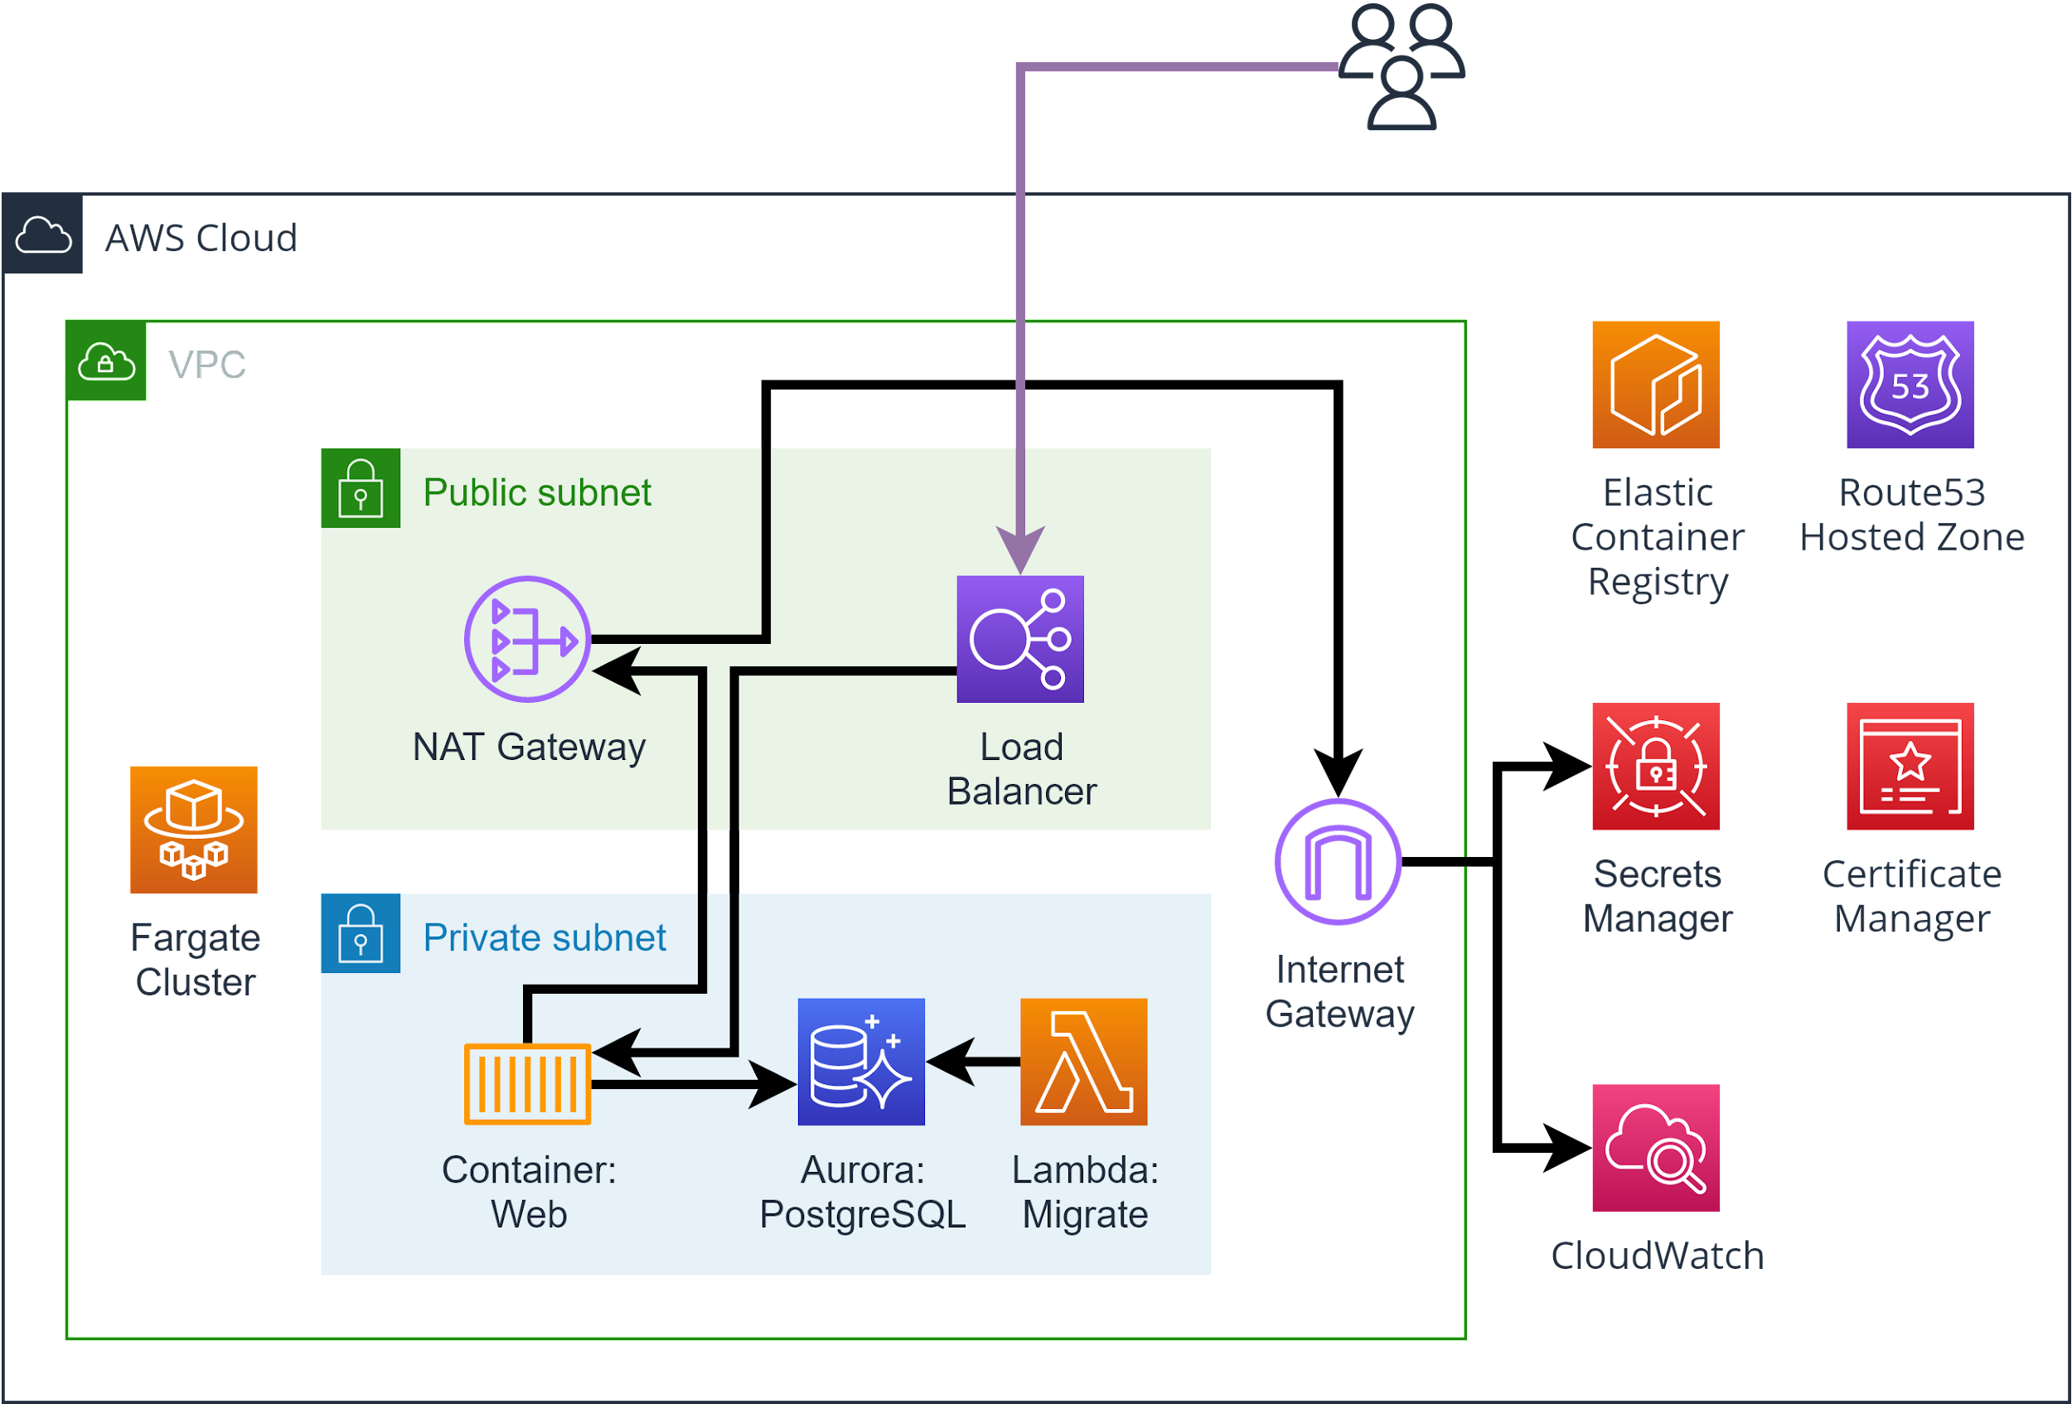
This simple app + database (.NET on AWS) is not terrible

Slide 12
What do you think is terrible?

Slide 13


































Titanium Sponsors
Platinum Sponsors
Gold Sponsors

Slide 14


Let’s continue the conversation
Visit the Headspring booth!
www.headspring.com
vasudha.prabhala@headspring.com
Notes:
Come visit us at the booth - we have swag, raffles, and learn more about our open job roles and our client projects
You can also learn more at headspring.com, or feel free to email me

